Slide 1

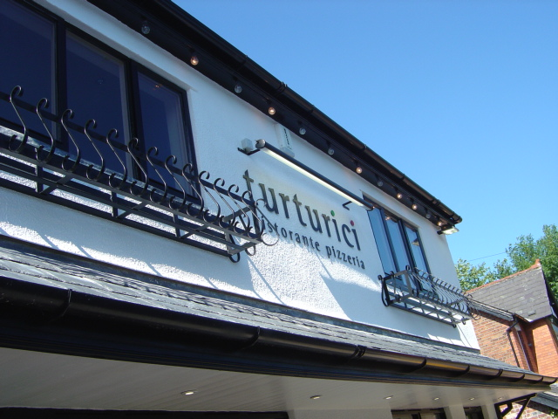
BACKGROUND COLOUR =
#624930
Nathan McBride
LOGO
ROLLOVER BUTTONS!
Home
About Turturici
Turturici Menu
Awards
Contact Us
IMG
HEADING 1 – WEBSITE TITLE
H1, B
HEADING 2 – WEBSITE SLOGAN
H2, Center
{H1 + H2 in Caps / H1 Size = 20 / H2 Size = 16 / Both in black}
Super long paragraph about how awesome Turturici is…
Once upon a midnight dreary, while I pondered weak and weary, Over many a quaint and curious volume of forgotten lore, While I nodded, nearly napping, suddenly there came a tapping, As of some one gently rapping, rapping at my chamber door. 'Tis some visitor,' I muttered, `tapping at my chamber door, Only this, and nothing more.' Ah, distinctly I remember it was in the bleak December, And each separate dying ember wrought its ghost upon the floor. Eagerly I wished the morrow; - vainly I had sought to borrow From my books surcease of sorrow - sorrow for the lost Lenore - For the rare and radiant maiden whom the angels name Lenore - Nameless here for evermore. And the silken sad uncertain rustling of each purple curtain Thrilled me - filled me with fantastic terrors never felt before; So that now, to still the beating of my heart, I stood repeating `'Tis some visitor entreating entrance at my chamber door - Some late visitor entreating entrance at my chamber door; - This it is, and nothing more,‘ Presently my soul grew stronger; hesitating then no longer, `Sir,' said I, `or Madam, truly your forgiveness I implore; But the fact is I was napping, and so gently you came rapping, And so faintly you came tapping, tapping at my chamber door, That I scarce was sure I heard you' - here I opened wide the door; - Darkness there, and nothing more.
White text box, black 2px border
{P Size = 11 in black}
FONT = GEORGIA / BACKGROUND COLOUR = #FFFFFF

Slide 2

Home
About Turturici
Turturici Menu
Awards
Contact Us
turturici~ Homepage
Pizzeria – Ristorante - turturici
Founded upon the warmth and friendliness at the heart of the Turturici legacy, the traditional Italian ristorante combines timeless charm with casual elegance to offer our guests a thoroughly authentic and enjoyable dining experience.
Facilities:
Car park
Disabled toilets
Gift vouchers available
No children under 12 years of age
Turturici does not operate a bookings system
Large groups by prior arrangement only

Slide 3
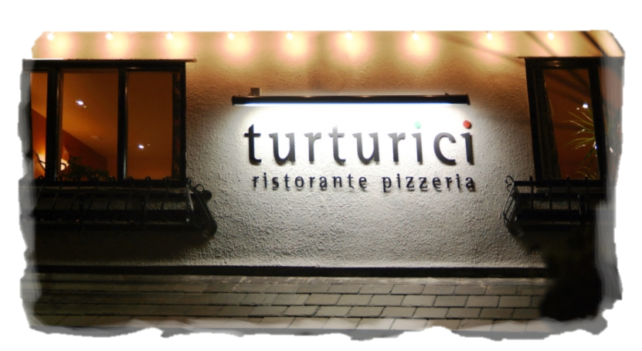
Home
About Turturici
Turturici Menu
Awards
Contact Us
turturici~ About/History of Turturici
Pizzeria – Ristorante - turturici
Our Heritage:
The Turturici family originate from the province of Agrigento, on the south coast of Sicily. The head of the family, Filippo Turturici, owns agricultural land which is farmed to this day, where generations of the Turturici family have been brought up cooking with locally grown and handpicked produce such as olives, almonds, oranges and lemons.
From these modest beginnings stem Giuseppina’s passion for traditional and authentic Sicilian food; it is this passion that inspired her to open an Italian restaurant in Cheshire, which would remain true to the heritage and tradition of her family.

Slide 4
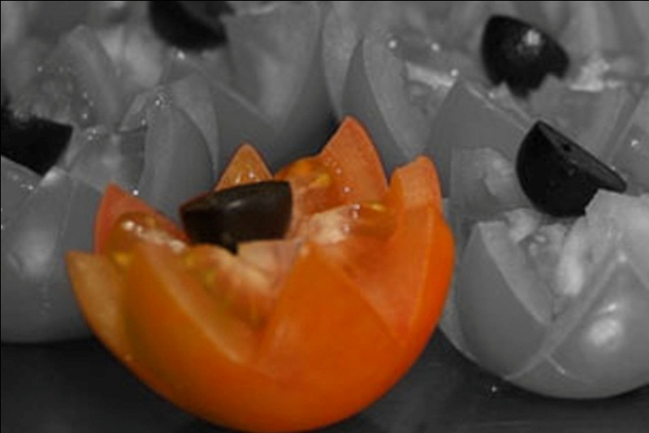
Home
About Turturici
Turturici Menu
Awards
Contact Us
turturici~ Turturici Menu
Pizzeria – Ristorante - turturici
Food and Wine:
Turturici offers an extensive and appealing menu combining classic and contemporary Italian dishes. The varied menu is prepared using only the highest quality food and wine, whilst fresh produce is sourced responsibly from local suppliers renowned for excellence. The menu features an expansive
range of pizza, pasta, seafood and meats, which our team of chefs ensure are always prepared fresh to order and cooked to exacting standards.
Our personally selected wines comprising regional favourites from Italian vineyards complement the diverse menu on offer, with a flavour and bouquet to suit every palate

Slide 5
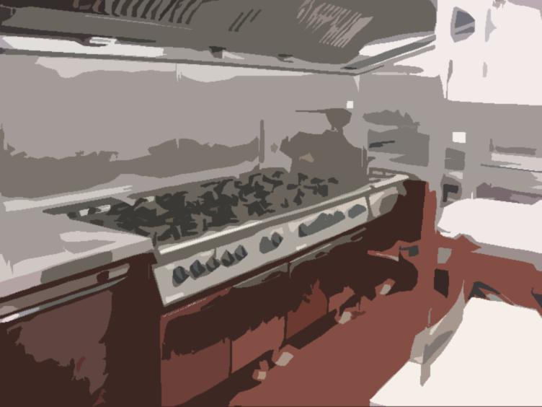
Home
About Turturici
Turturici Menu
Awards
Contact Us
turturici~ Awards & Recommentations
Pizzeria – Ristorante - turturici
Awards and Recommendations:
In addition to prestigious ‘Restaurant of the Year’ awards and accolades over the years, we are particularly proud to boast the coveted ‘5 stars’ for kitchen hygiene, and ‘platinum’ awards for food safety. Turturici has consistently achieved a ‘5 star’ rating and ‘platinum’ award.
Food hygiene rating scheme: The scheme is a Food Standards Agency and local authority initiative, which provides diners with information about the hygiene standards in food outlets.
www.food.gov.uk/ratings

Slide 6


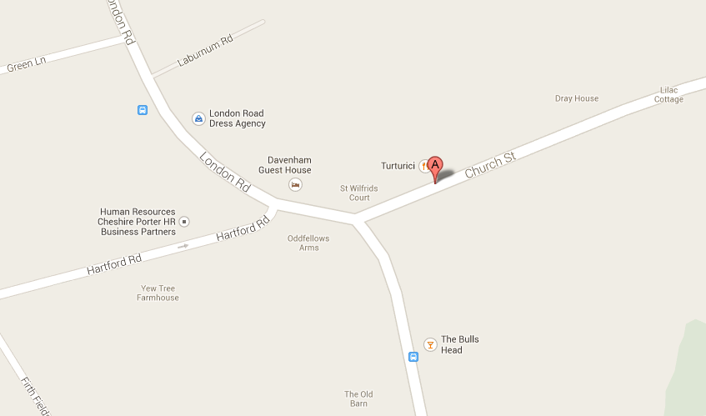
Home
About Turturici
Turturici Menu
Awards
Contact Us
turturici~ Contact Us
Pizzeria – Ristorante - turturici
Contacts:
9-13 Church Street,
Davenham,
CW9 8NE
01606 331155
info@turturici.co.uk
Where we are:
Opening Times:
Open 7 evenings from 6pm – close
(Saturdays 5:30 – close)

Slide 7
Home
About Turturici
Turturici Menu
Awards
Contact Us
BY NATHAN MCBRIDE

